Slide 1
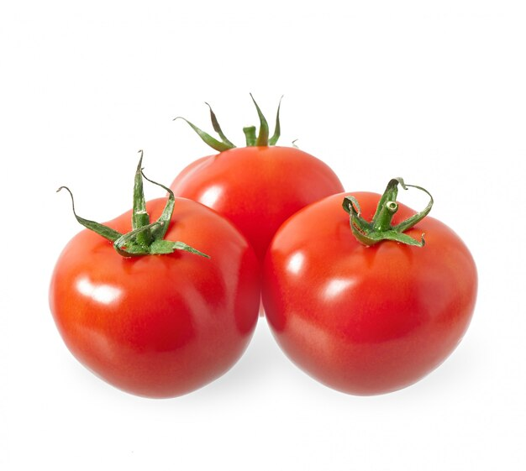
Tomato Grand Challenge
Basic Details of the Team and Problem Statement
Track | Vertical 3
Participant Category | Student
Vertical Title | Innovative post-harvest treatments, packaging and technologies for long term storage to minimize post- harvest losses during transportation and storage to avoid panic selling due to perishability.
Team Name | Electro Astroids
Team Leader Name | Vishwa S
No. of Team Members | 5
No. of Team Mentor | 2
For development of Comprehensive and focused intervention in design of tomato value chain

Slide 2
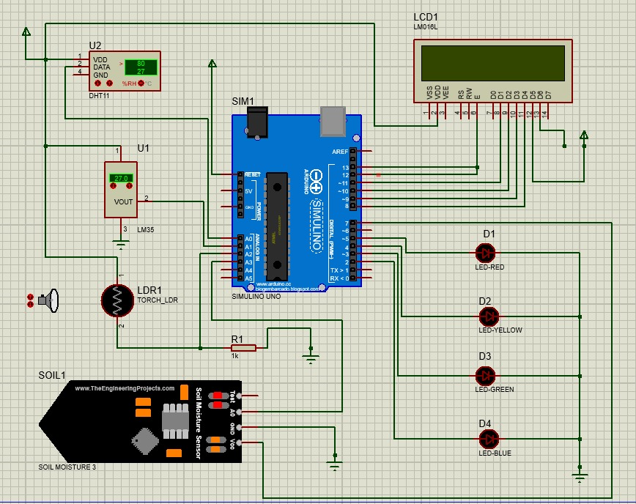
Idea / Approach Details
Evaporative Cooling System with galvanized steel and aluminum enhances shelf life of tomatoes by 24 days.
Eco-friendly papaya cardboard packaging reduces losses, providing biodegradable, and moisture-resistant solutions.
Proteus Simulation:
Technology stack
CAD/CAE Software | SolidWorks
Programming | Embedded C
Manufacturing | Machining, fabrication, papaya cardboard production
Quality Control | Material and packaging testing
Environmental Test | Life cycle analysis
Impact | Reduced post-harvest losses, increased profitability, sustainable resource use, and environmental benefits.
Novelty | Compactable ECS design and innovative papaya-based packaging for transportation.

Slide 3
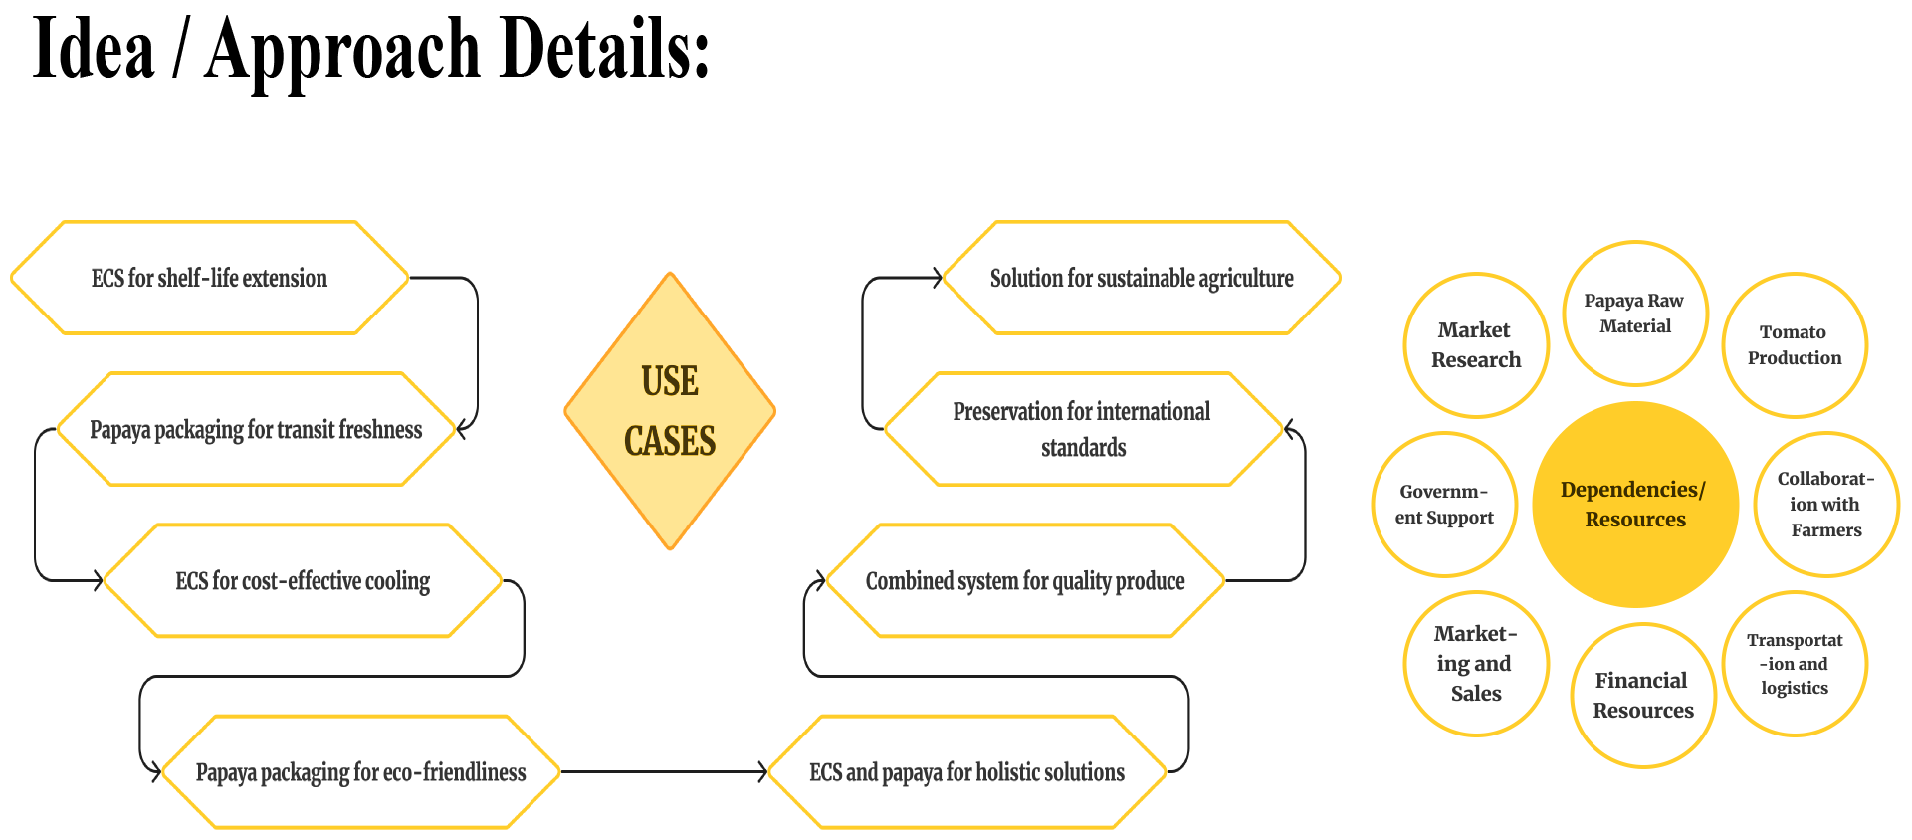
____________________________

Slide 4
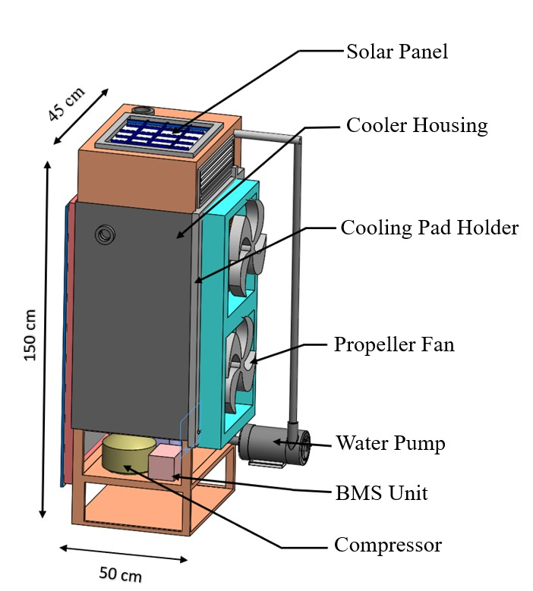
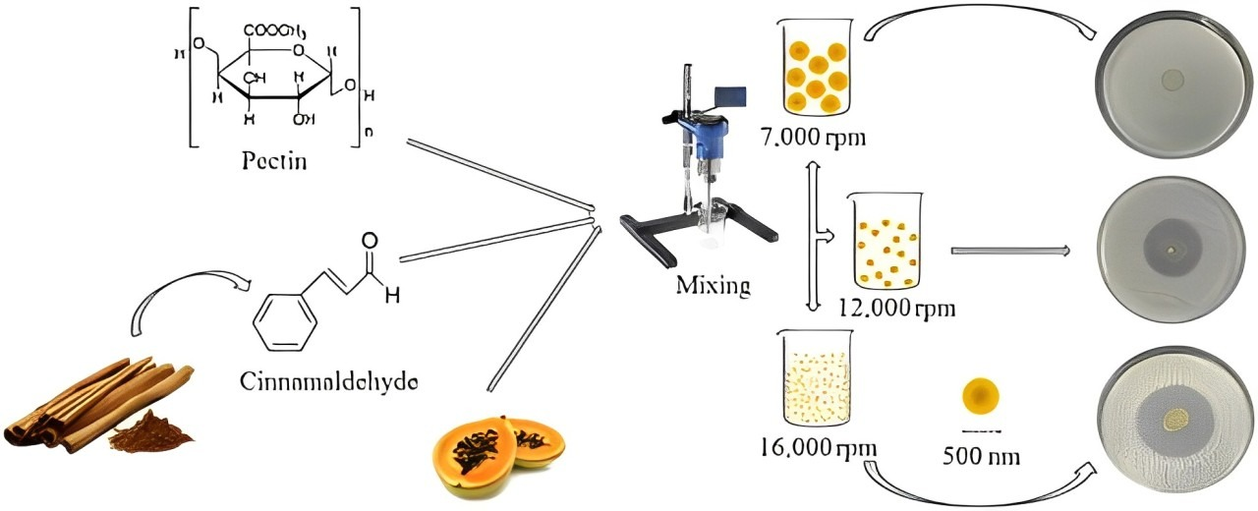
Proposal for Stage 1:
Idea to Proof of Concept/ Prototype
Papaya has high tensile strength of 20 - 30 MPa when hydroxypropyl methylcellulose is used as a binding agent.
Tomato packaging materials with high methoxyl pectin binding agent exhibit 8.9 - 14.8 MPa of tensile strength.
Cancer cells are significantly reduced when pectin collected at different stages of papaya ripening are applied.
Evaporative Cooling System
For Papaya-based Tray

Slide 5
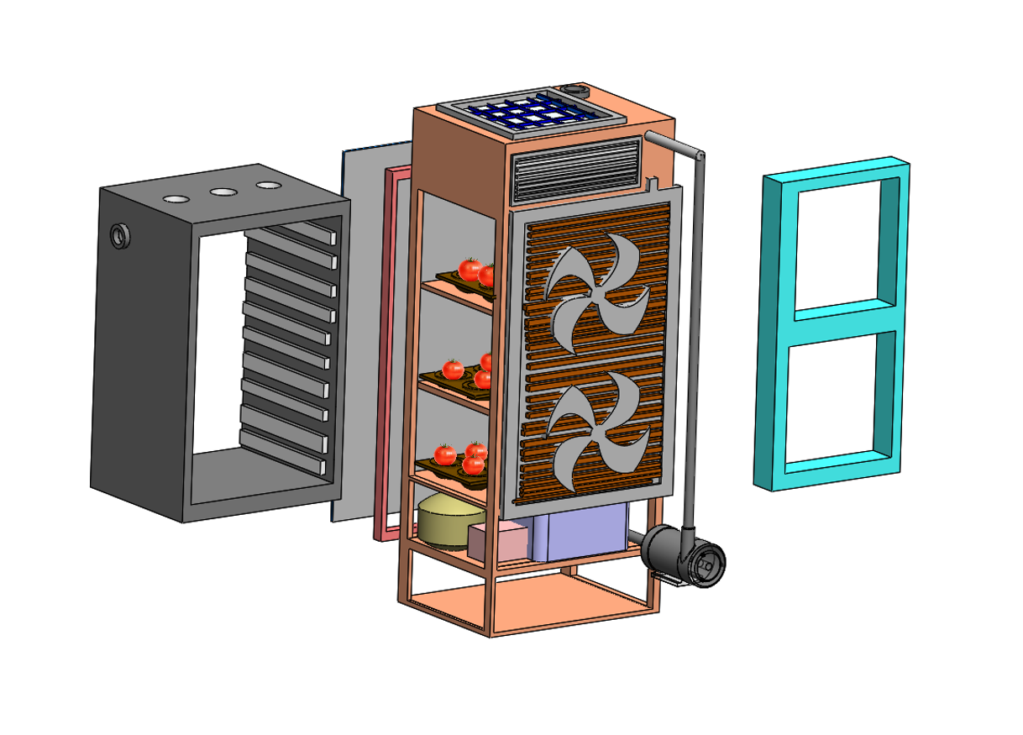
Research methodology :
Evaporative cooling system involve passing fresh air over water-saturated surfaces.
Collect data on temperature variations, humidity levels, and the condition of preserved tomatoes at regular intervals.
Monitoring the temperature based on which the water will be evaporated.
Implement the designed evaporative cooling system in a controlled environment for tomato preservation.
Consider factors such as energy efficiency, cost-effectiveness, and the overall quality of preserved tomatoes.

Slide 6
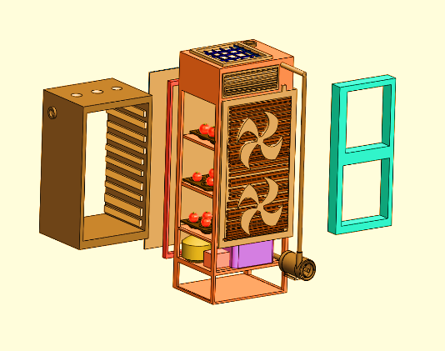
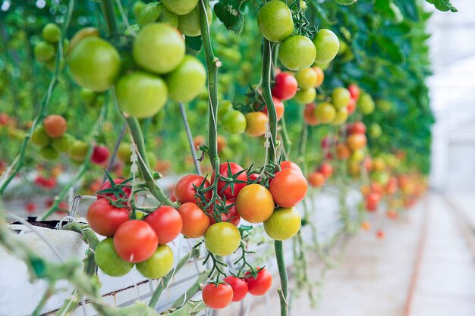
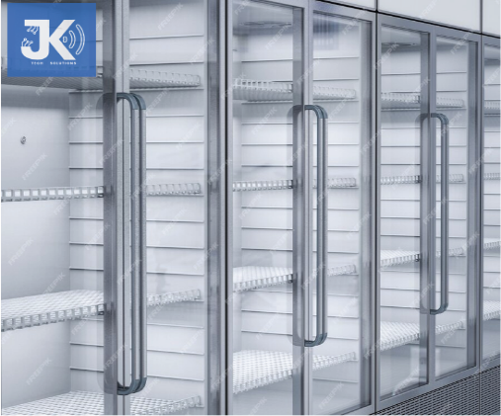
Objectives and Outputs:
Month | 1st Month | 2nd Month | 3rd Month | 4th Month
Objectives | Development of proof of concept | Implementation of developed concept | Field implementation of the concept | Introducing the product in our startup
Process

Slide 7
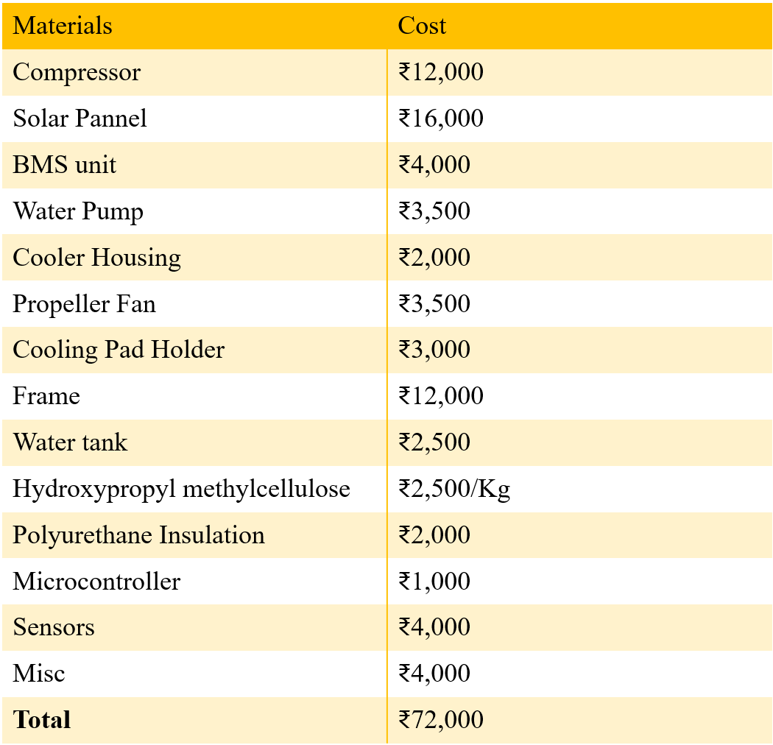
Development cost:

Slide 8





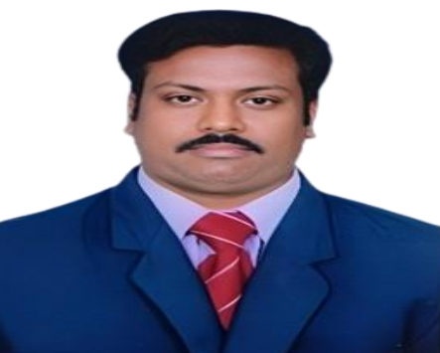
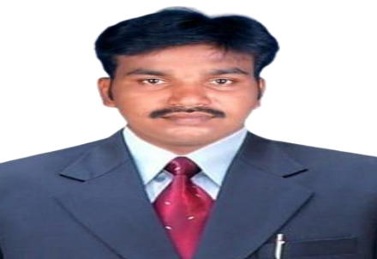
Team Member & Mentor Details :
Photo
Name | Vishwa S | Subash P | Pradeep V | Nikesh S | Sanjai B | Murugan B S | Jeyakumar P
Email | vishwa05054@gmail.com | subashsivamani9595@gmail.com | velpradeep.vp1@gmail.com | nikeshs3996@gmail.com | sanjaibalakrishnan15@gmail.com | principal@mkce.ac.in | jeyakumarp.ece@mkce.ac.in
Contact no | 9345190256 | 9943249594 | 9790366017 | 9360507224 | 9025422429 | 9865230477 | 9994723025

